Slide 1
Hedge Funds and Recession
Hans Petersen

Slide 2


Hedge Funds

Slide 3




Outside Research
Higher risk, lower returns: What hedge fund investors really earn
Dichev amd Yu
Hedge Fund Performance 1990-2000: Do the "Money Machines" Really Add Value
Kat and Amin

Slide 4
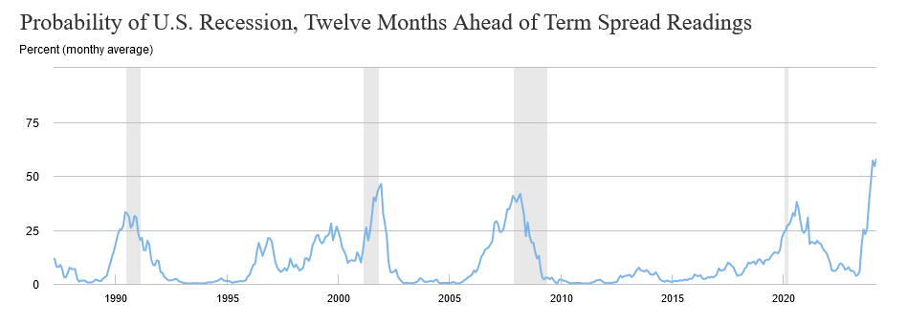
Recessions

Slide 5
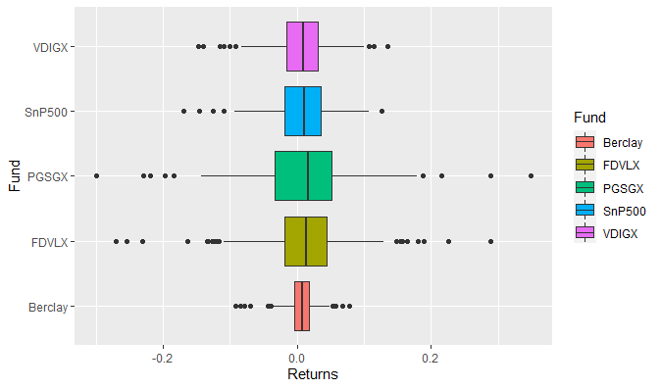
Statistical analysis

Slide 6
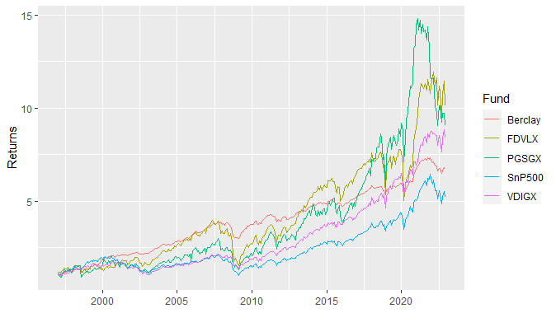
Statistical analysis (continued)

Slide 7
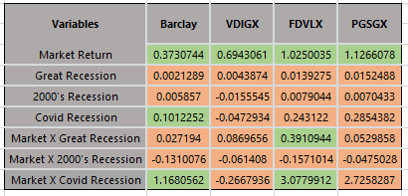
Regression analysis
$$Fund return =Market return+Great Recession+{2000}^{′}s Recession+CovidRecession+Market return∗ Great Recession+Market return ∗ {2000}^{′}s Recession \text{+ }\text{Market} return \text{ * }\text{Covid} \text{Recession}$$

Slide 8


Conclusions

